Slide 1

MEDICARE
CENTRE FOR DEVELOPMENT OF ADVANCED COMPUTING, NEW DELHI
Under the guidance of
Mr. Ankit Kumar
PG DAC (Sept 2022) Group-9
1)Pol Pranil Sudam 220910120035
2)Sandeep Kuraria 220910120043
3) Dhanshree Dongre 220910120019
4)Sumit Kumar Gupta 220910120050

Slide 2
Existing System
The Existing system was paper-based. keeping track of all the activities (like records of its patients, doctors and other staff personals) and their records on paper is very cumbersome and error prone.
It was very inefficient and a time-consuming process Observing the continuous increase in population and number of people visiting the hospital.
Recording and maintaining all these records on paper was highly unreliable, inefficient and error-prone.
It is too slow and cannot provide updated lists of required things within reasonable timeframe.
It is also not economically & technically feasible to maintain these records on paper.

Slide 3
Proposed System
It is necessary for the hospitals to keep track of its day-to-day activities & records of its patients, doctors that keep the hospital running smoothly & successfully. Our objective is to digitalize all the version of the manual system , and we named it as “Medicare”.
It also aims at providing low-cost reliable digitalization of the existing systems.
The purpose of this project is to digitalize, the process of day-to-day activities like Registering New Patient, Assigning a Doctor to new patient.
As the proposed software product is the providing online medical consultancy. The system will be used in any clinic etc. Hospitals (small to medium scale) can used it to get the information from the patients and then storing that data for future usages.
The intention of the system is to reduce over-time pay and increase the number of patients that can be treated accurately.

Slide 4
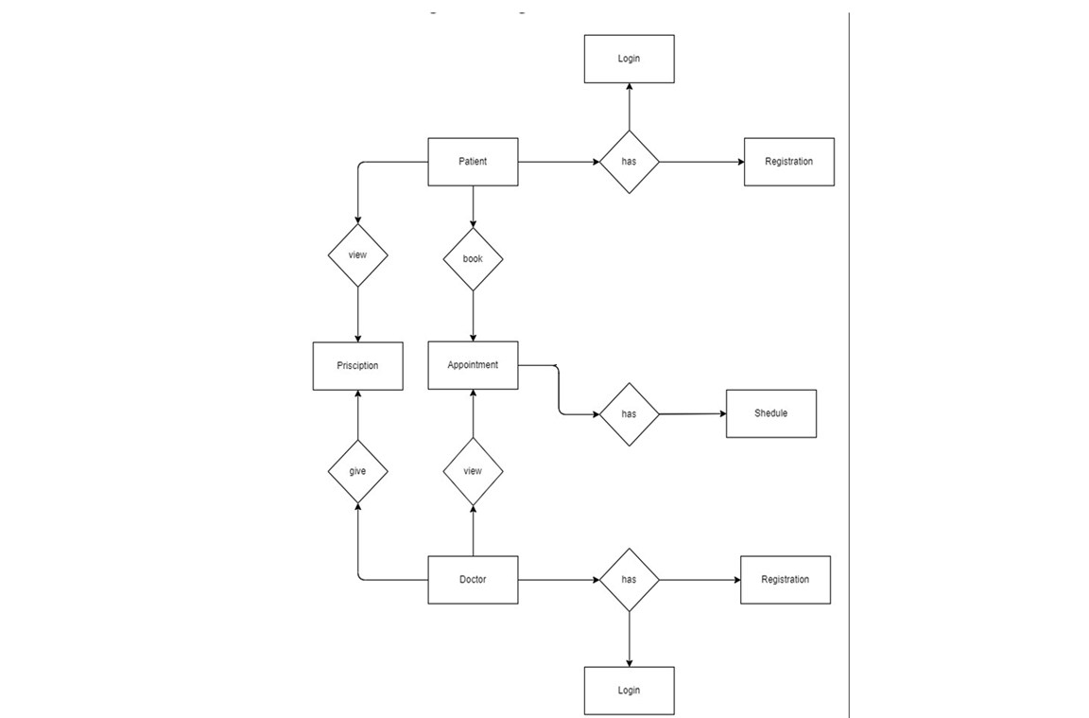
ARCHITECTURE
Architecture Diagram

Slide 5
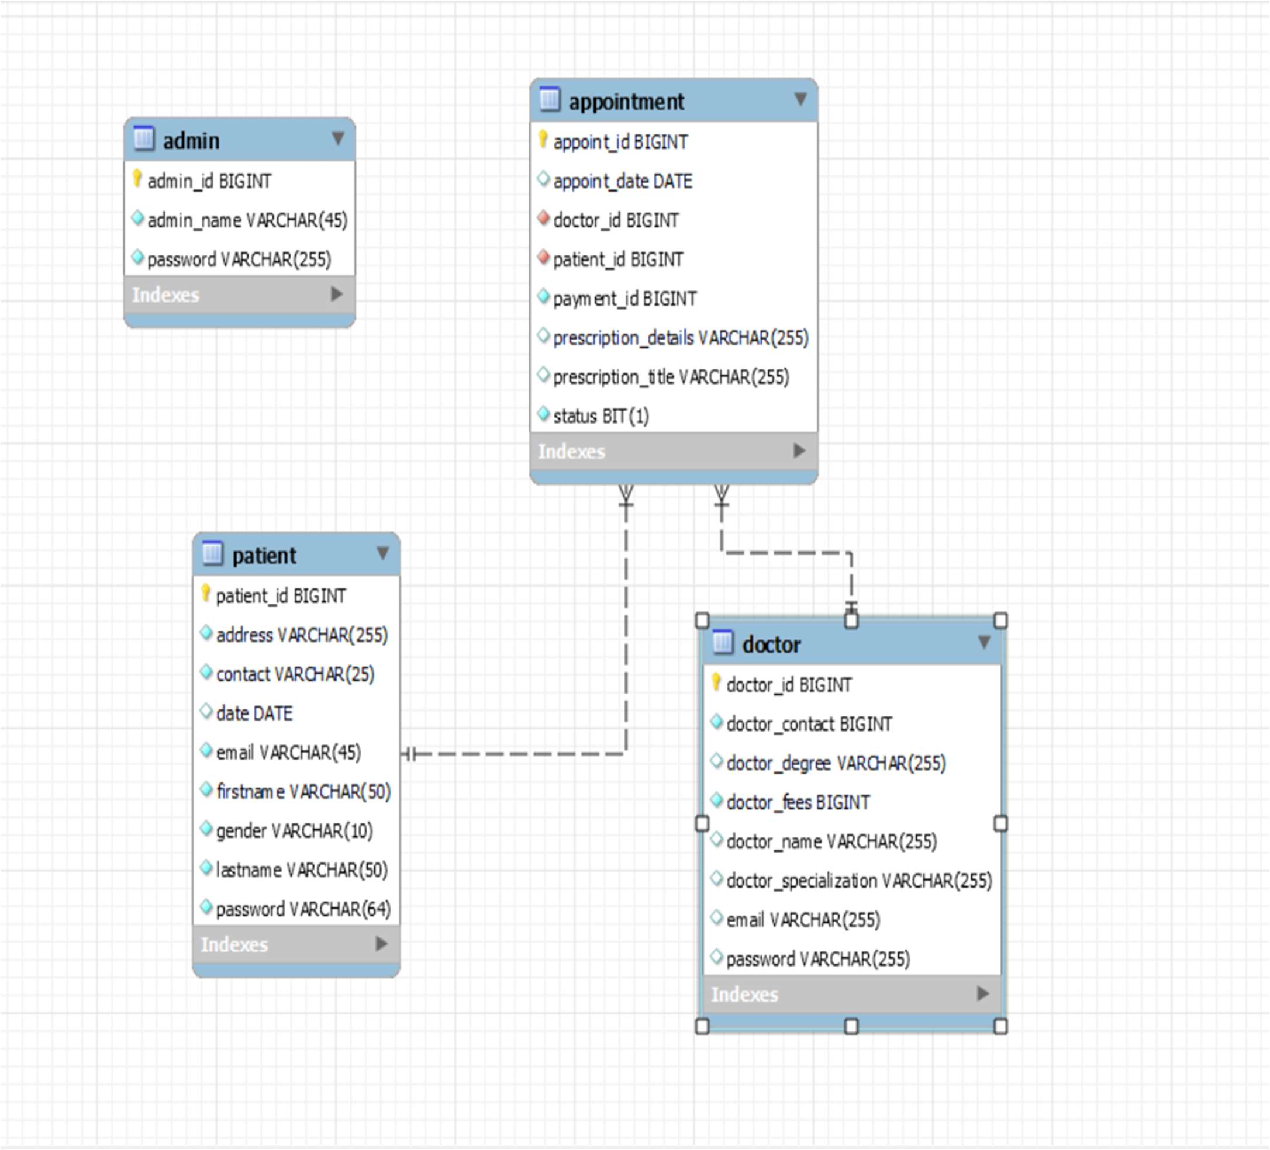
ER-Diagram

Slide 6
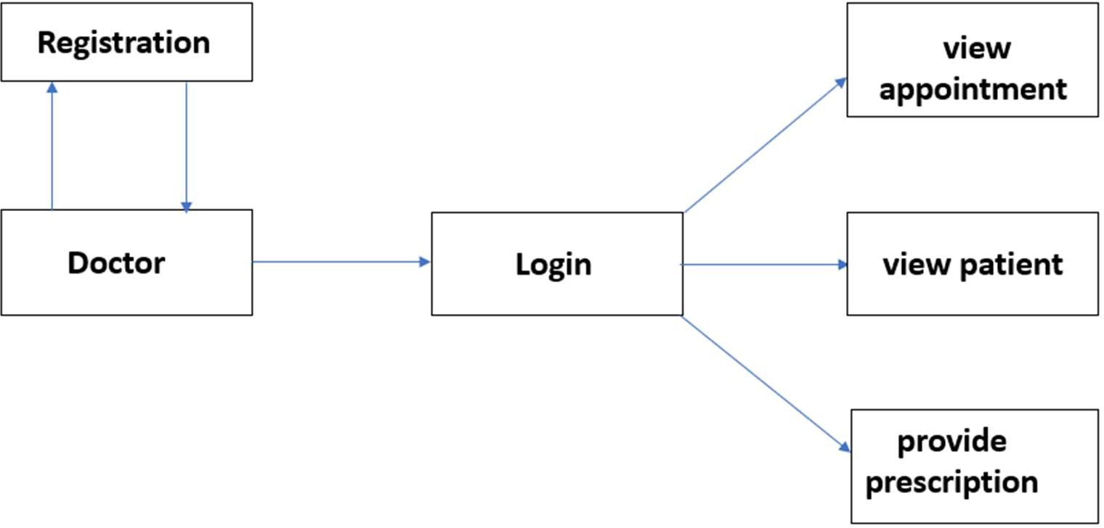
Activity Diagram (Doctor):

Slide 7
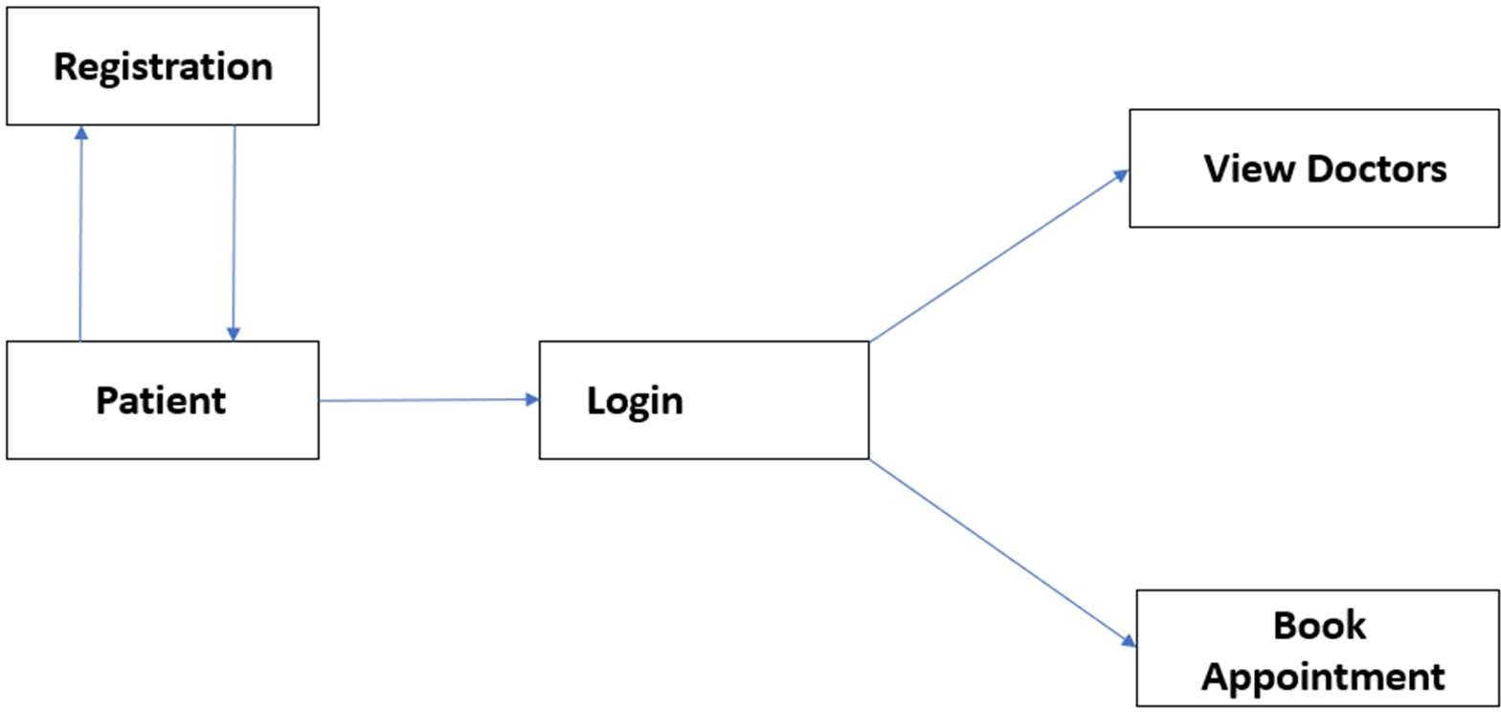
Activity Diagram (Patient):

Slide 8
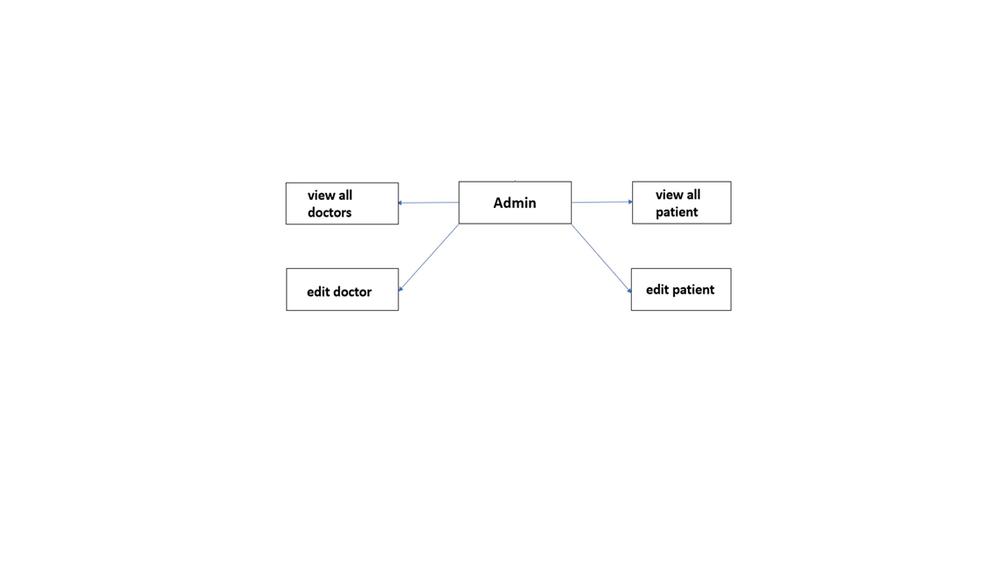
Activity Diagram(Admin)

Slide 9
MODULES
Login module:
Login
Registration
Home page
Doctor
Appointment

Slide 10
MODULES
Admin module
Admin have to insert there username and password for login.
After insertion of correct username and password admin logged in the system.
Admin can see all the patients and doctors details.

Slide 11
Technologies
Front End: HTML5, CSS3, bootstrap5
Javascript6
React JS
Backend: Spring boot
Database:MYSQL

Slide 12
Features
Makes prescription readable and understandable to patients.
Eliminate redundancy in term of data storage. Data will be stored in a computer not heap of files.
Reduce the time wasted in retrieving data especially in finding a past health records.
Increase Efficiency and Interactivity in any area of specialization in the hospital.
Able to quickly collect and edit data, summarize result and adjust as well as collect errors promptly.

Slide 13
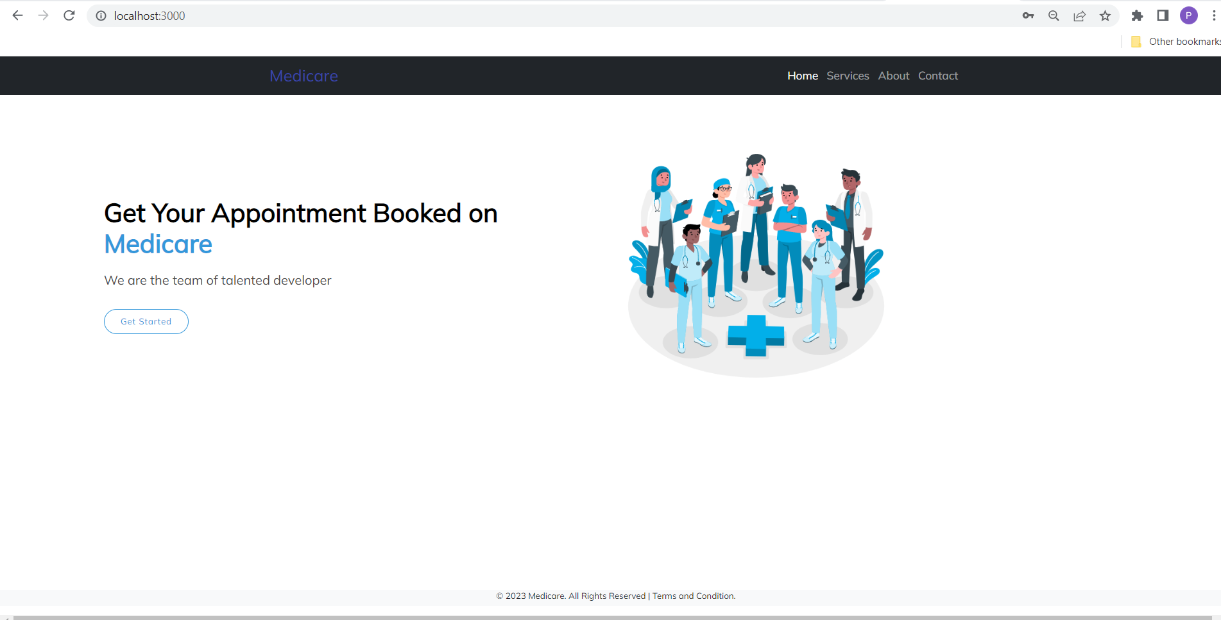
Home page

Slide 14
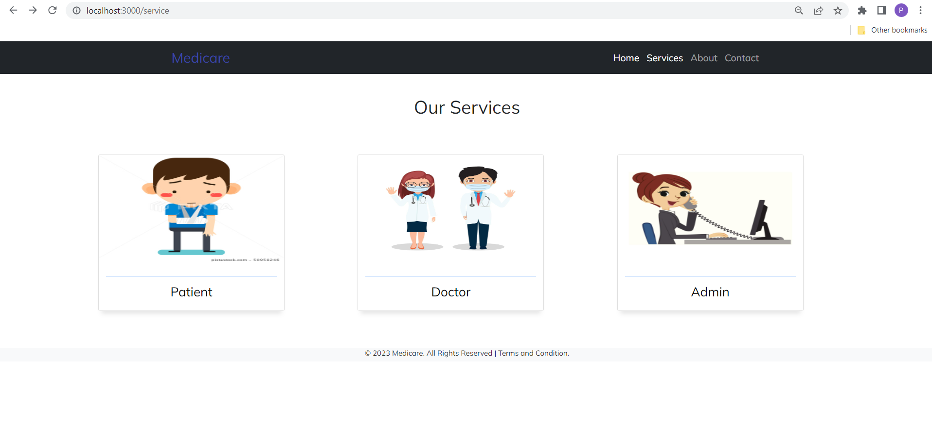
Service Page

Slide 15
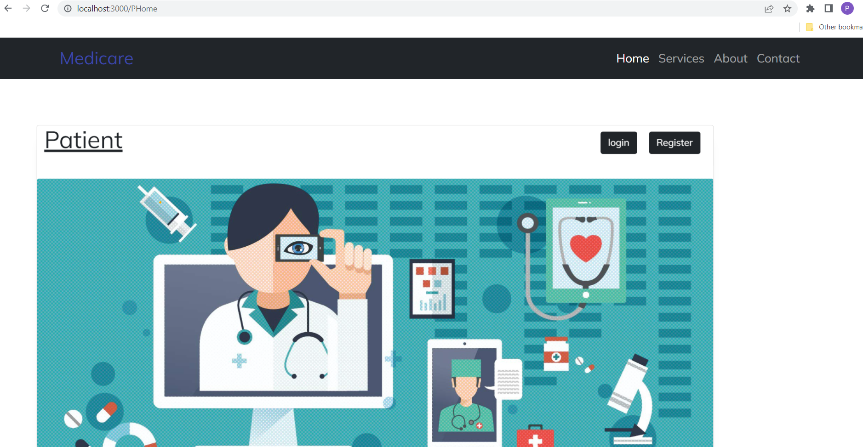
Patient Home Page

Slide 16
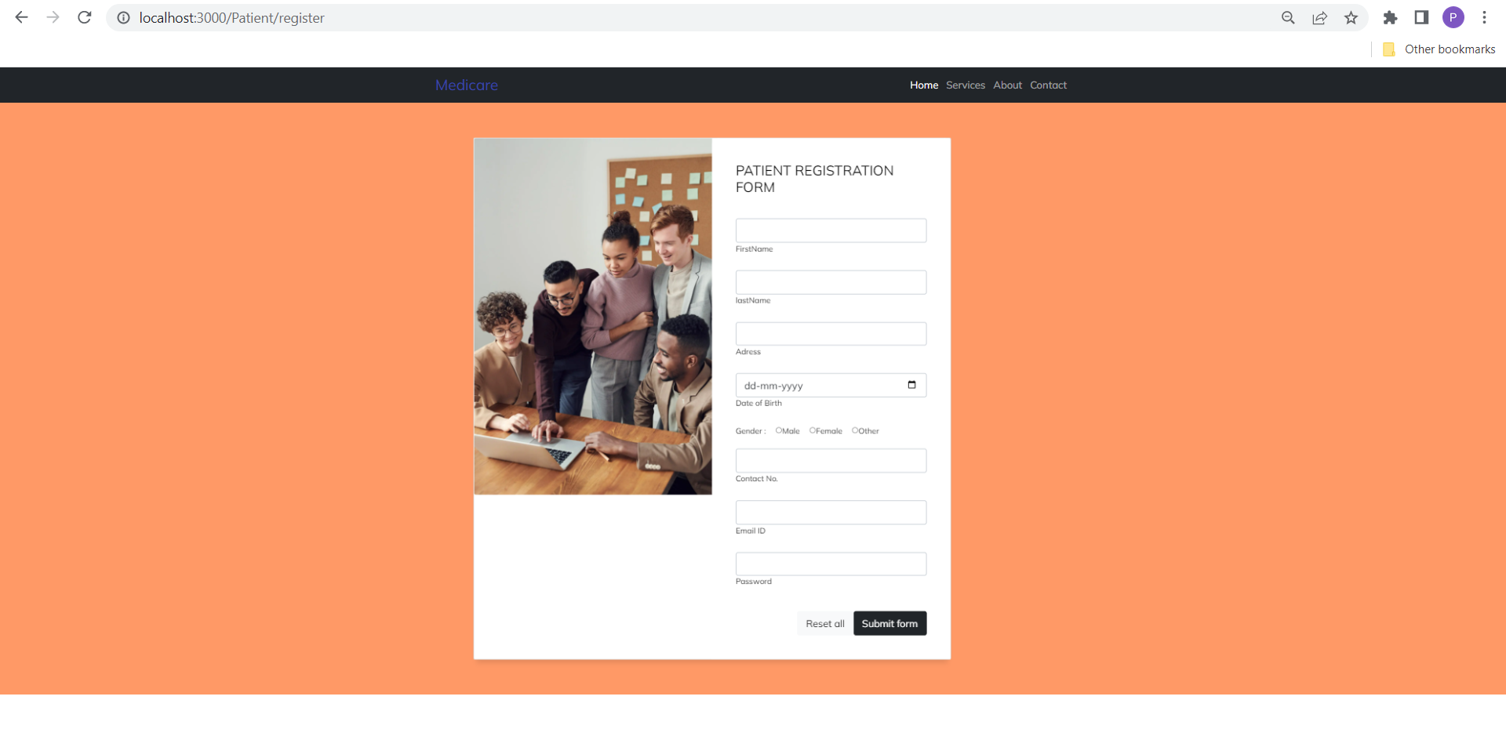
Patient Registration Page

Slide 17
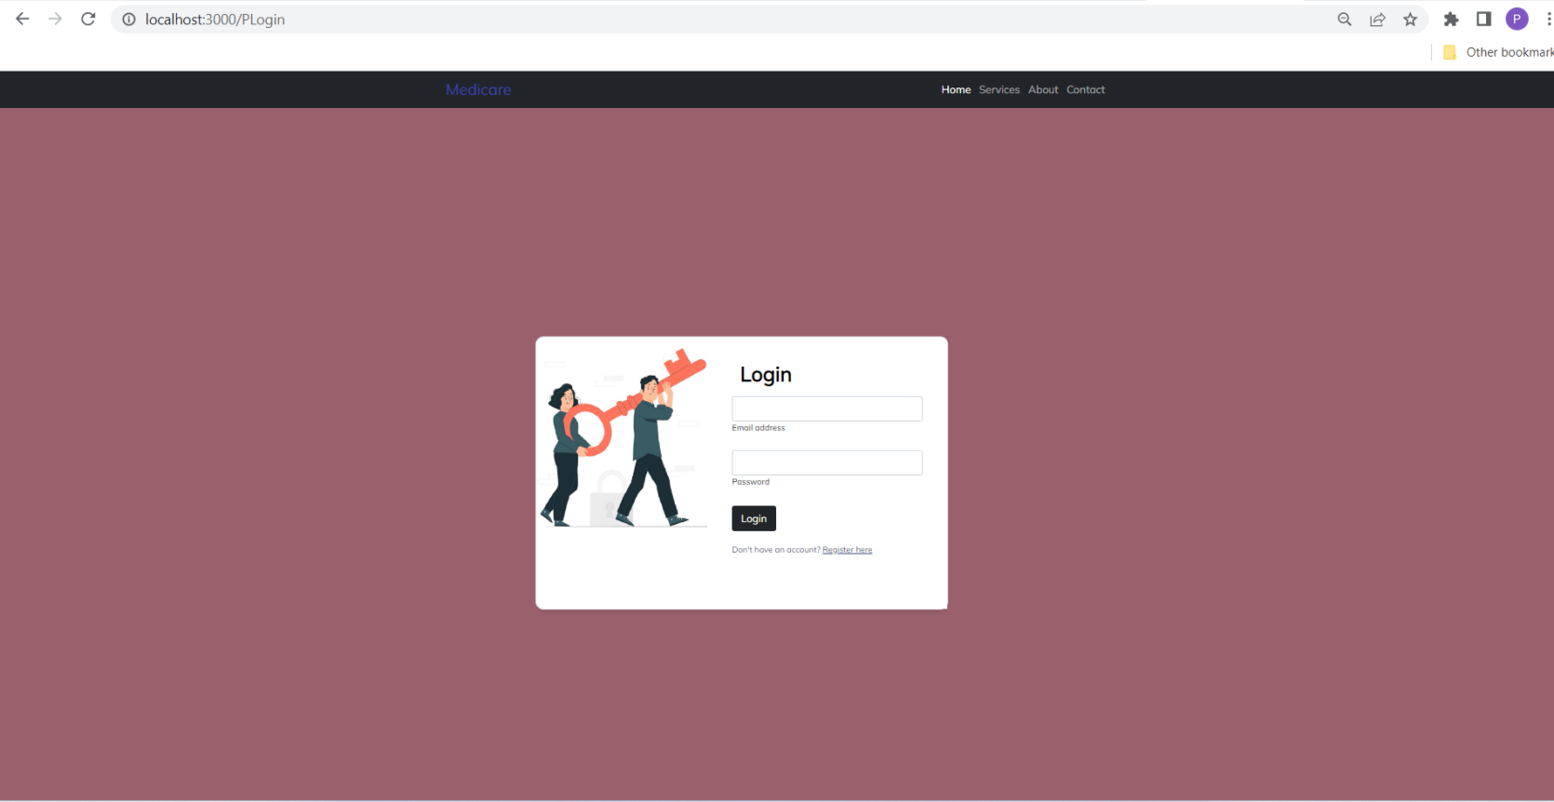
Patient Home Page

Slide 18
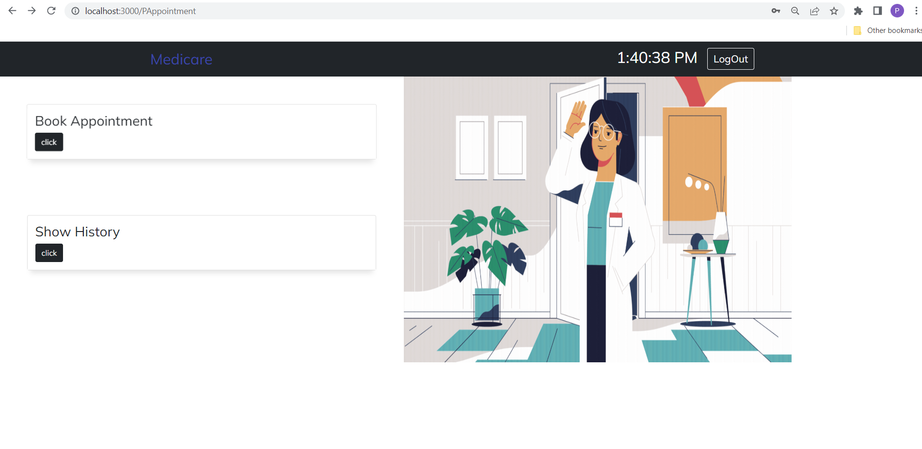
Patient Appointment Page

Slide 19
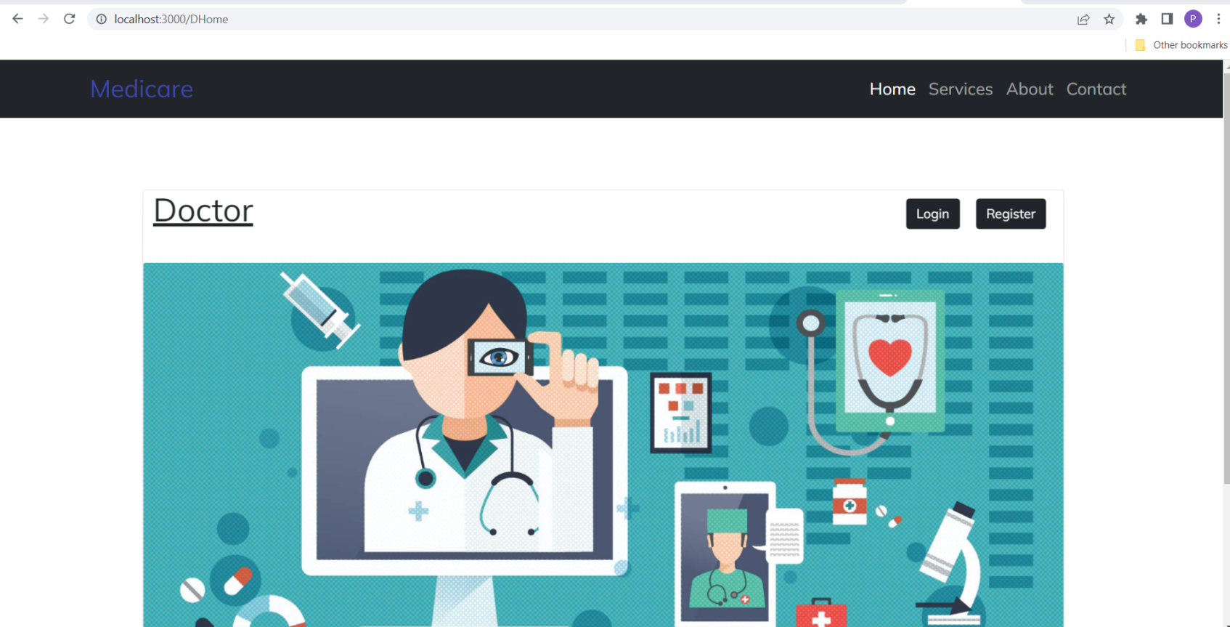
Doctor Home Page

Slide 20
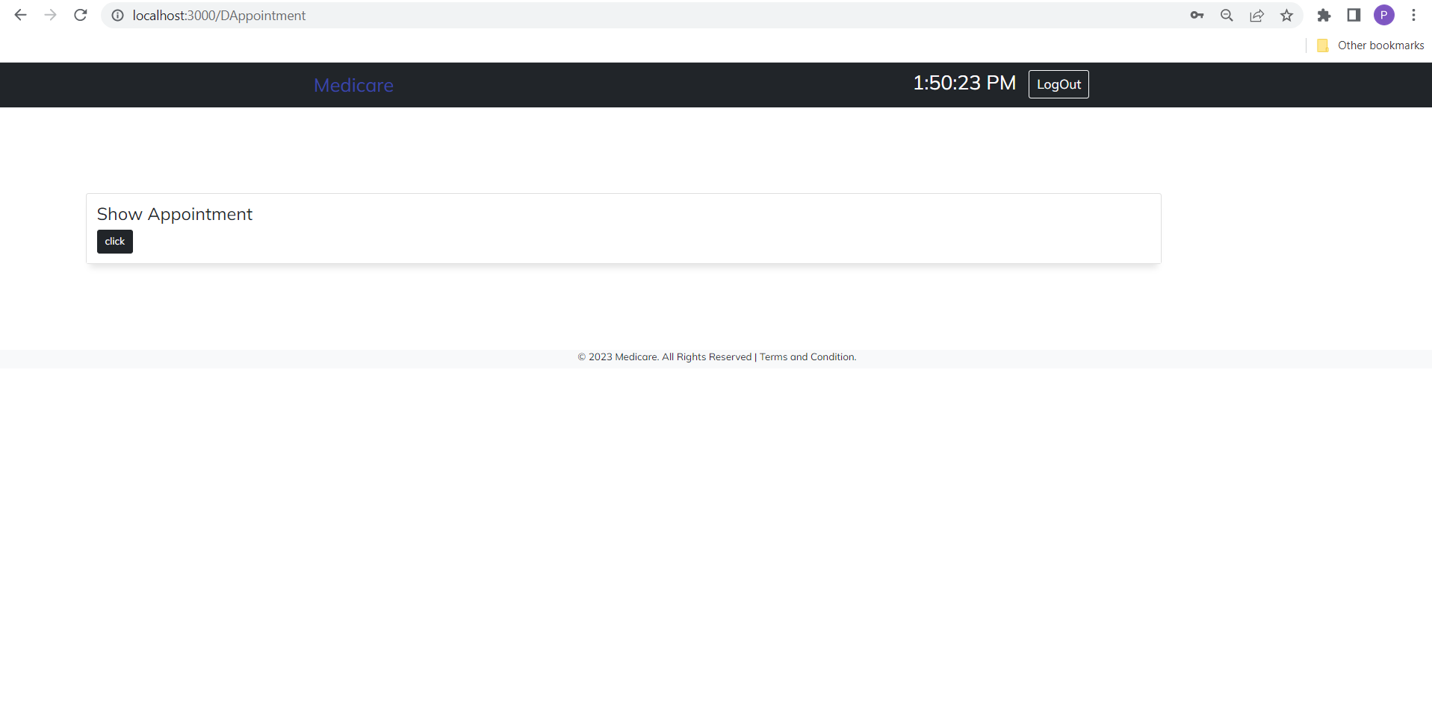
Doctor Page

Slide 21
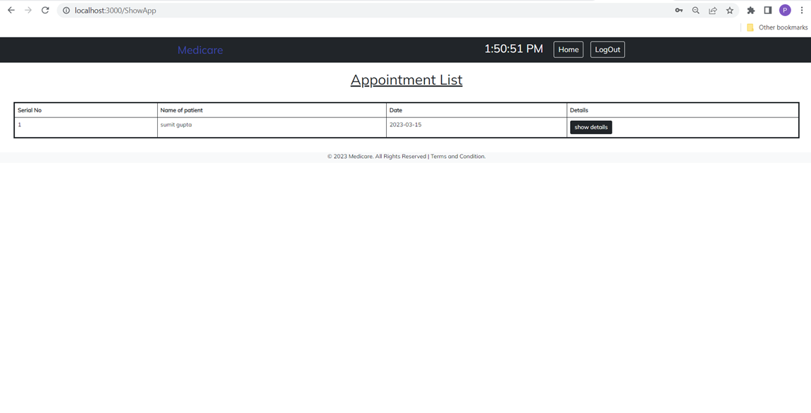
Appointment Page

Slide 22
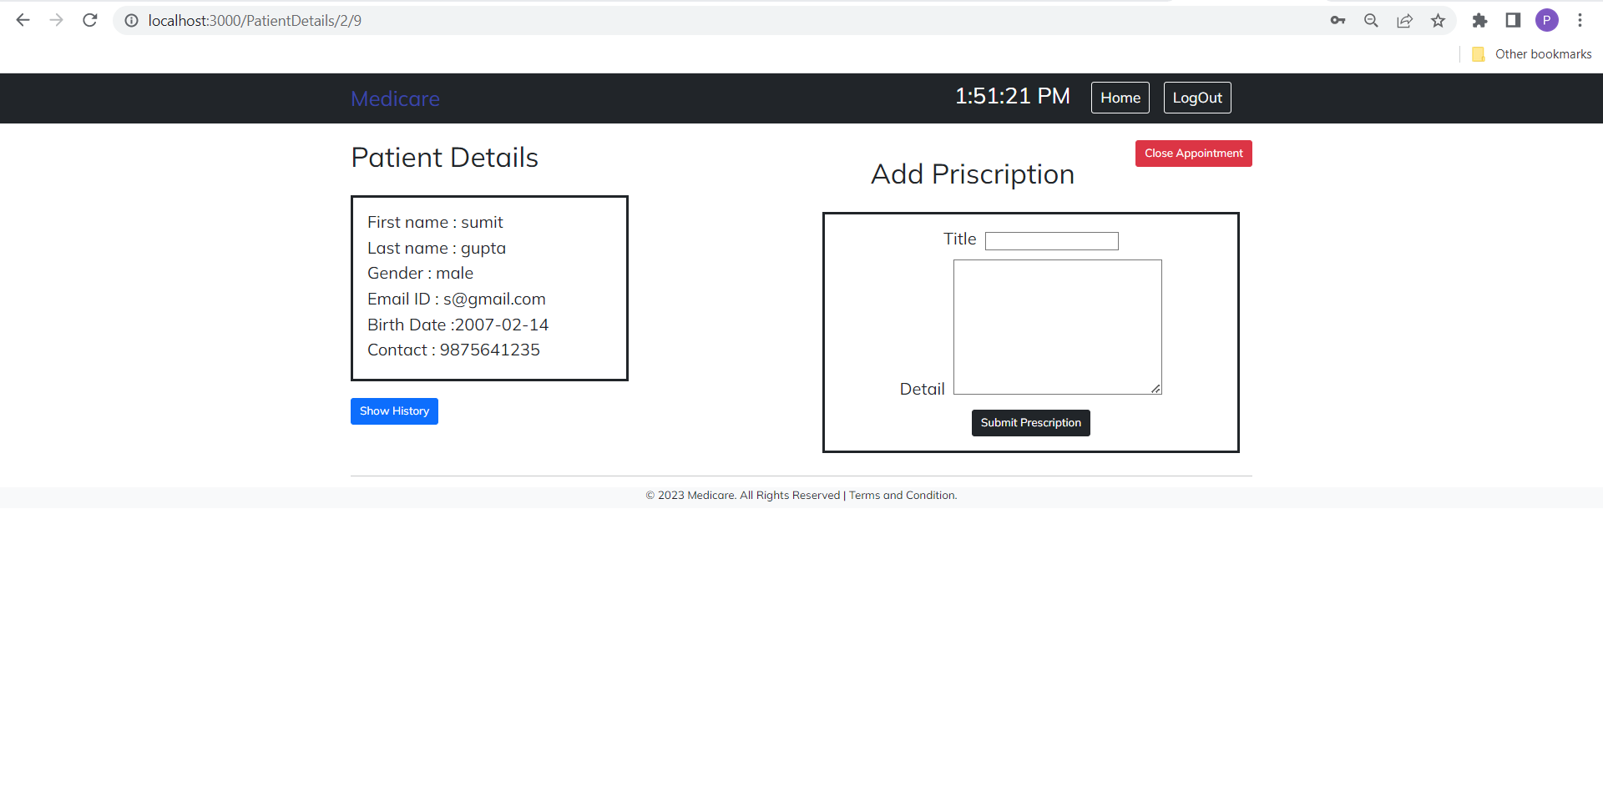
Appointment Details Page

Slide 23
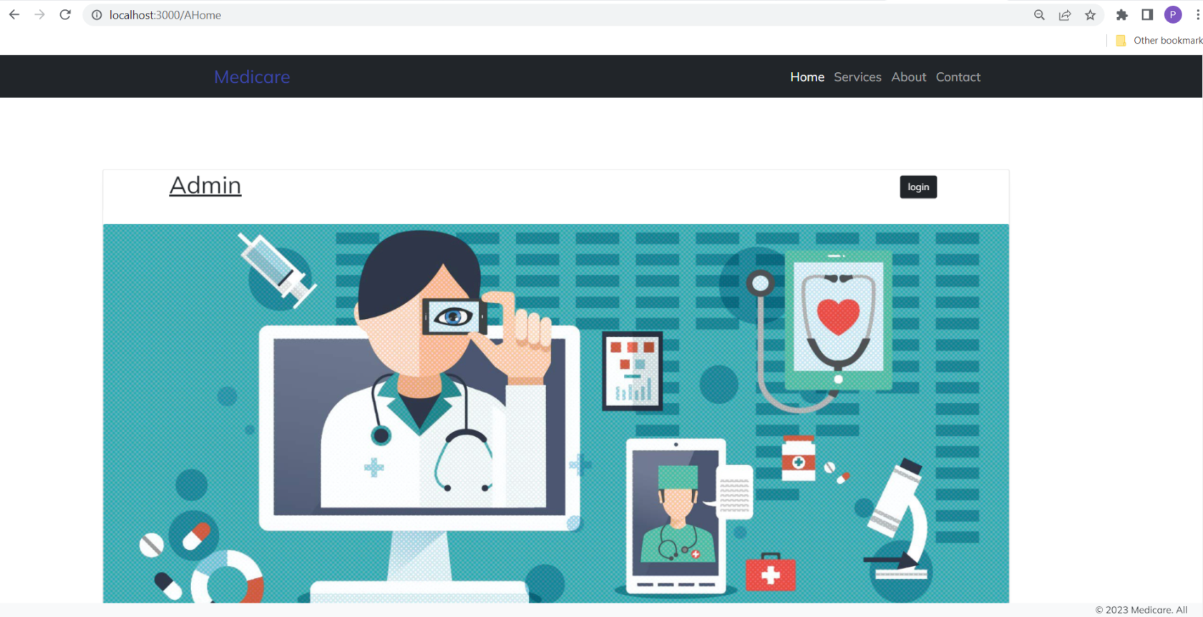
Admin Home Page

Slide 24
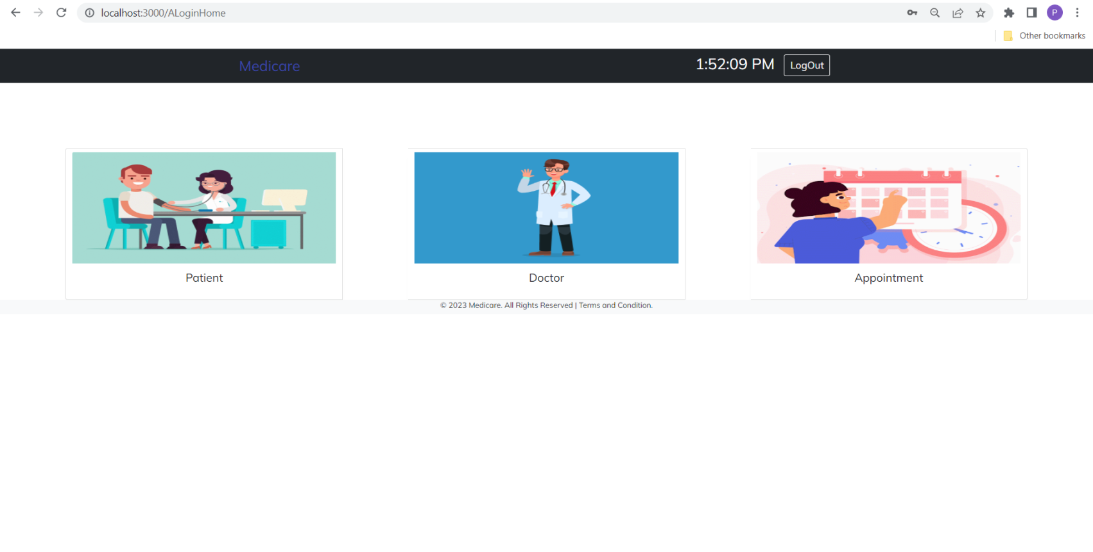
Admin Service Page

Slide 25
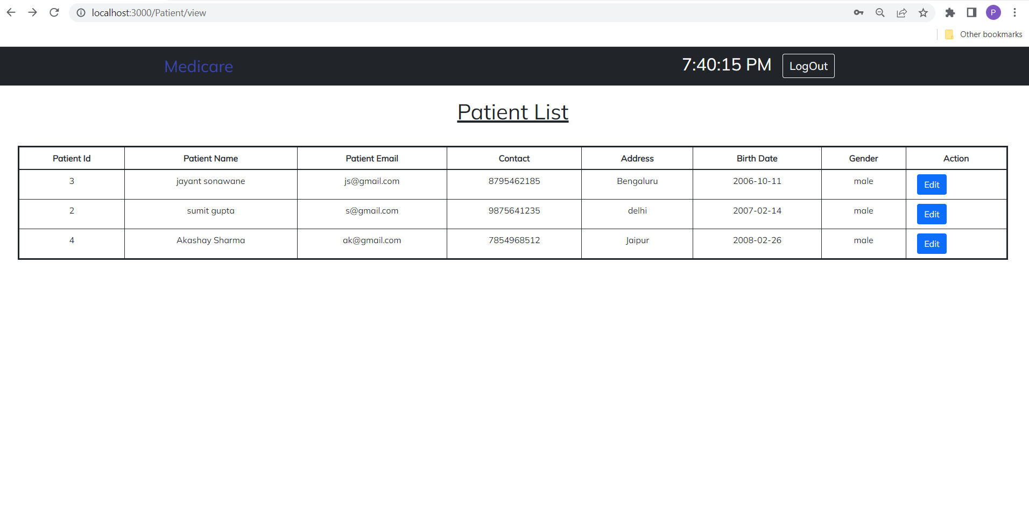
Patient List Page

Slide 26
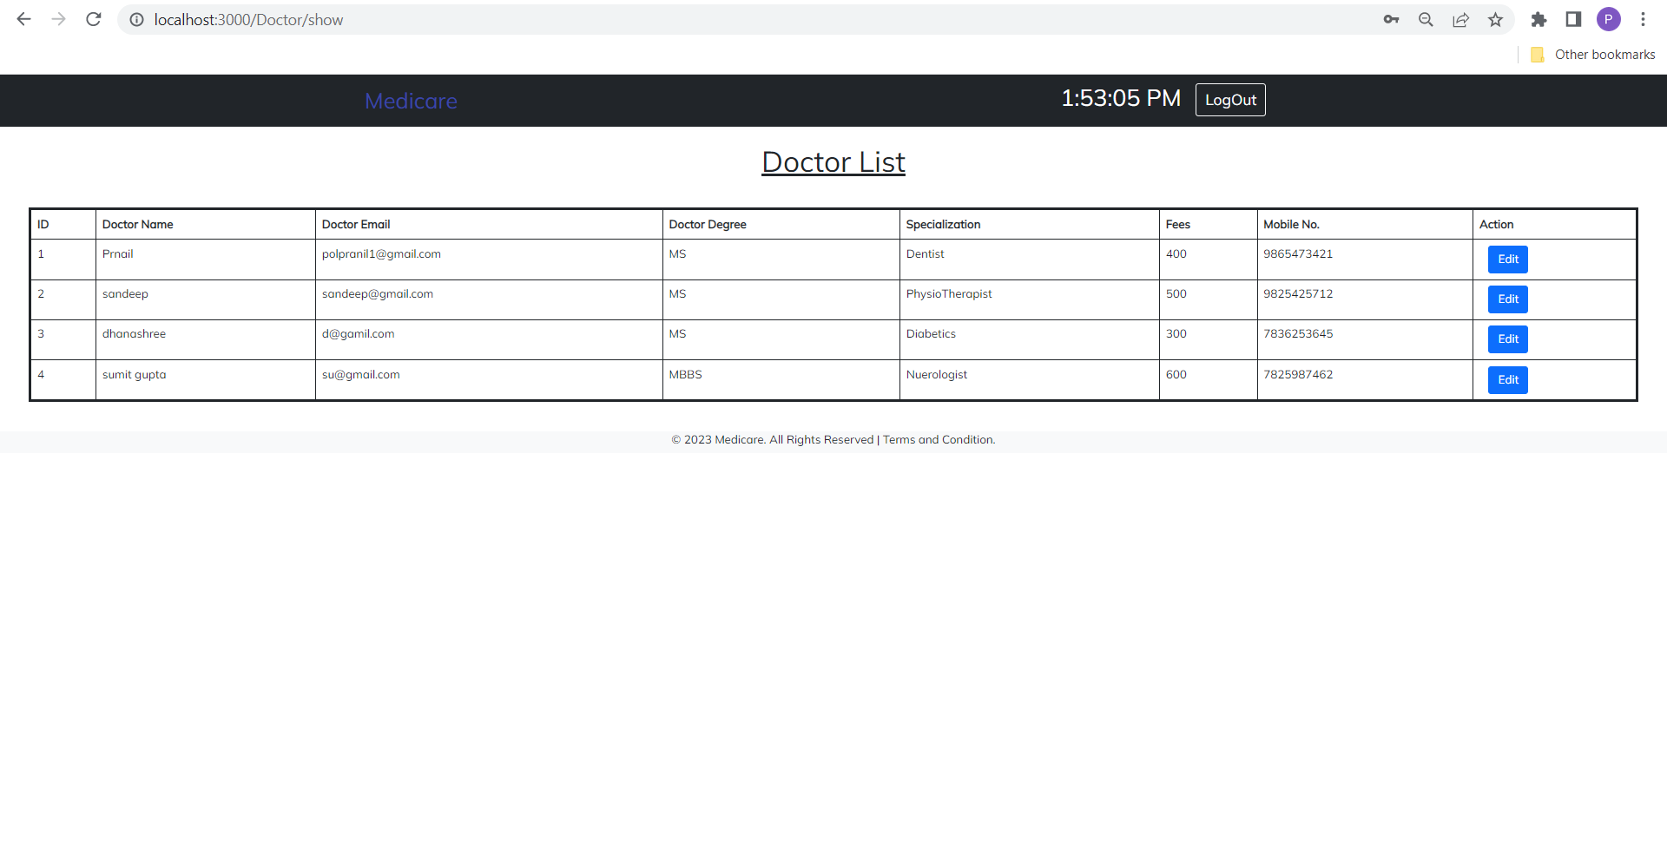
Doctor List Page

Slide 27
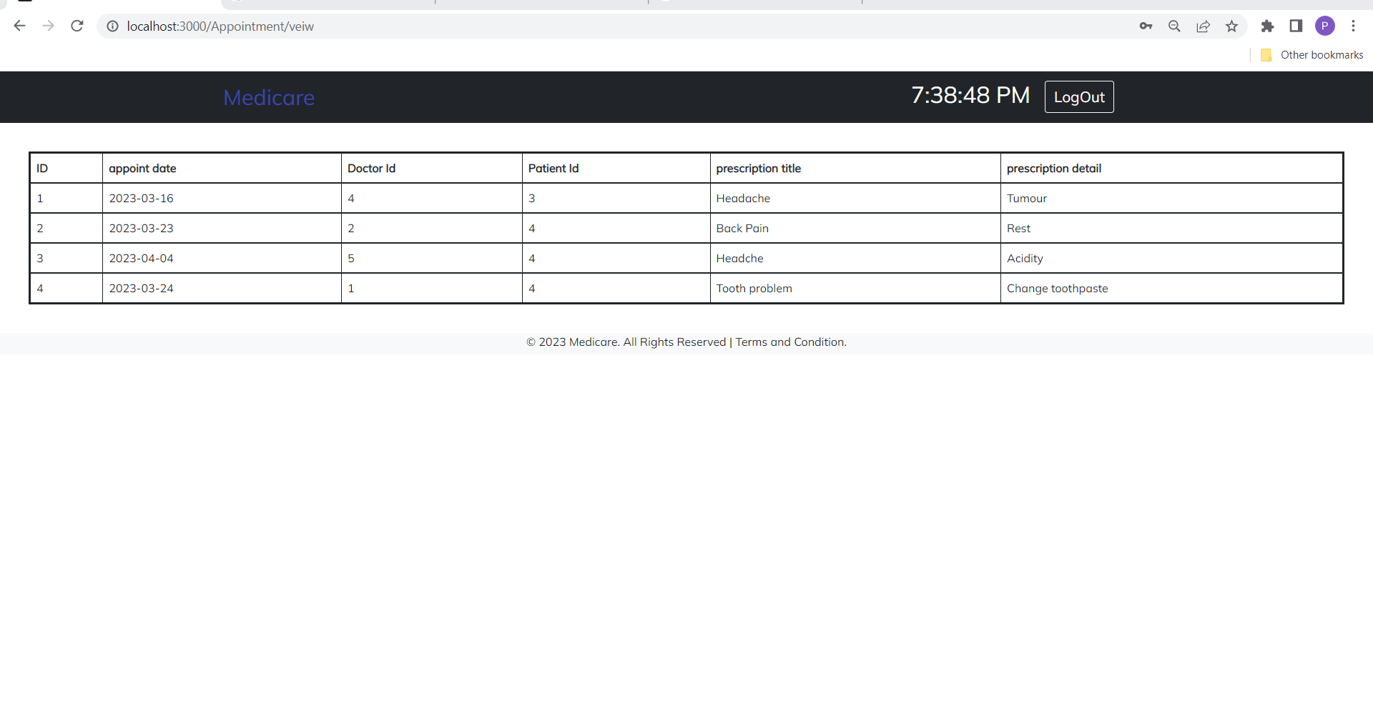
Appointment Page

Slide 28
CONCLUSION
This project helps in making paperless activities. It reduces the workload from Doctor and Receptionist.
It provides more ease and flexibility to Doctor, Administrator and Receptionist.
This digitalization has reduced costs of Hospital.
This work has created a little awareness and promotes the idea that the concept of paperless office is reality.

Slide 29
Thank You

